Slide 1
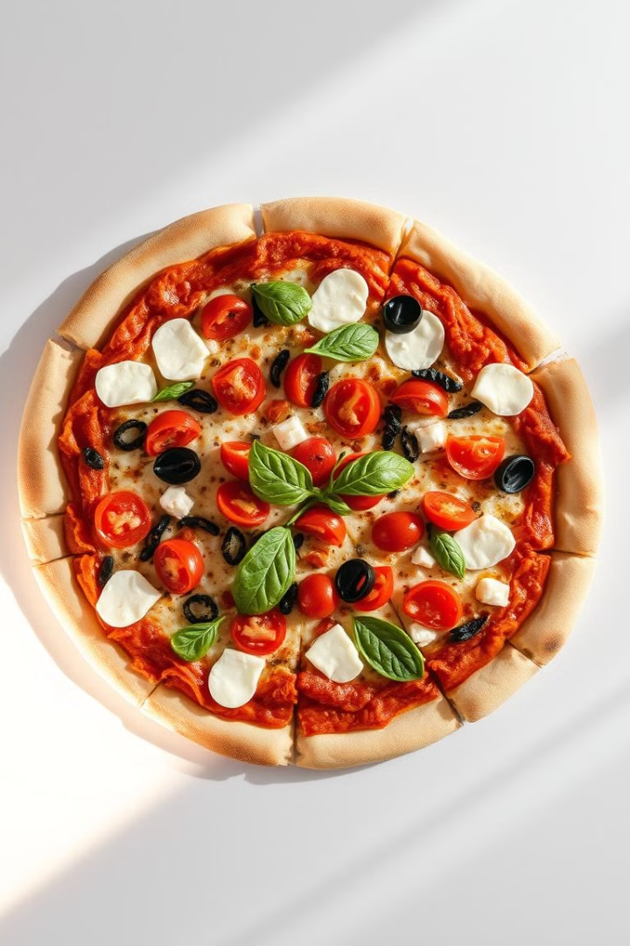
SQL PROJECT
ON
PIZZA SALES

Slide 2
Description:
The "Pizza Sales" project is a comprehensive analysis endeavor that delves into a complete dataset from a pizza store's operations throughout the year 2015.
The dataset initially in CSV format has been imported in SQL server . The primary objective of this project is to extract valuable insights from the data, enabling informed decision-making for the pizza business.
Data Cleansing and Preparation: Before conducting any analysis, the data is thoroughly cleansed and transformed to rectify any inconsistencies or errors.
SQL Database Design and Querying: A well-structured database schema is designed to effectively organize the various aspects of the pizza store's operations. SQL queries are formulated and executed to extract meaningful insights and KPIs. Some potential queries include:
Total sales revenue for the year.
Best-selling pizza flavors.
Customer demographics and ordering trends.
Busiest days and times for orders.
Average order value
Insights and Recommendations: The project concludes with actionable insights and recommendations. These insights guide the pizza store's management in making strategic decisions to optimize operations, improve customer satisfaction, and enhance profitability.
.

Slide 3
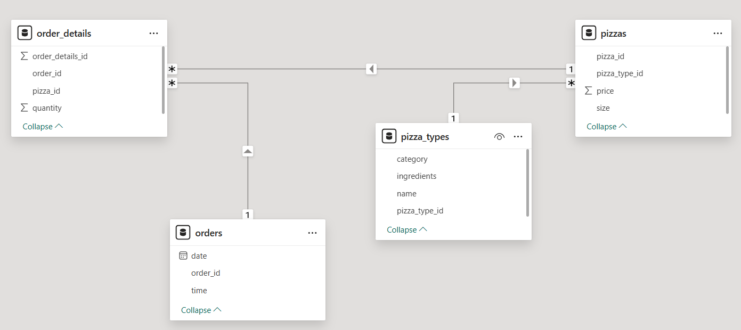
Data Model

Slide 4
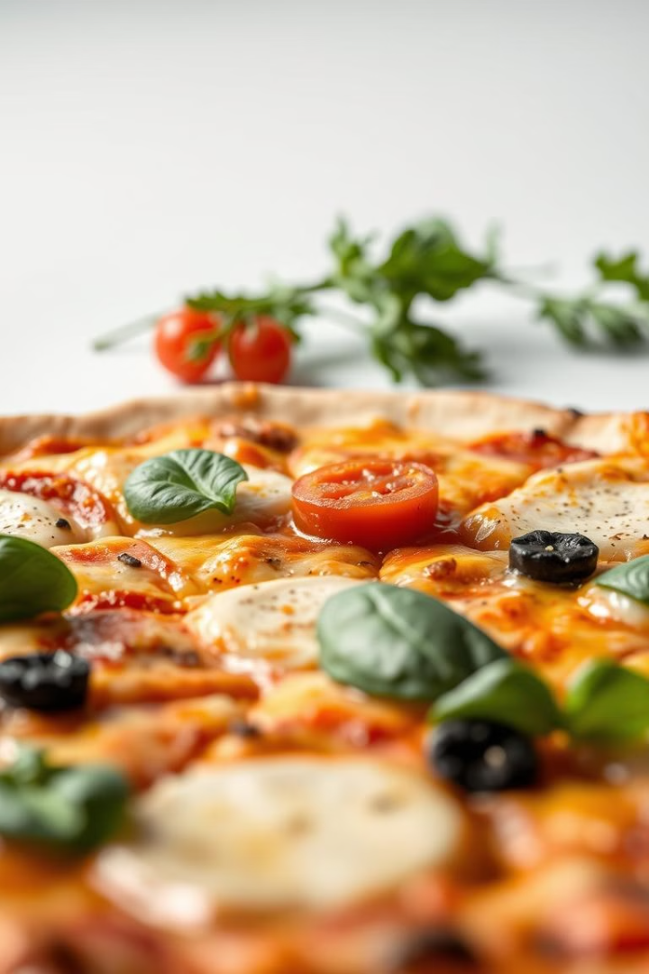
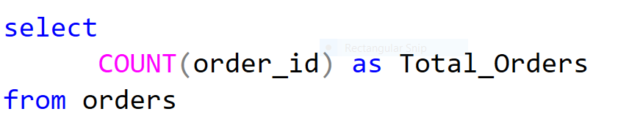
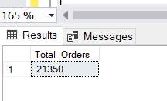
Retrieve the total number of ordered placed

Slide 5
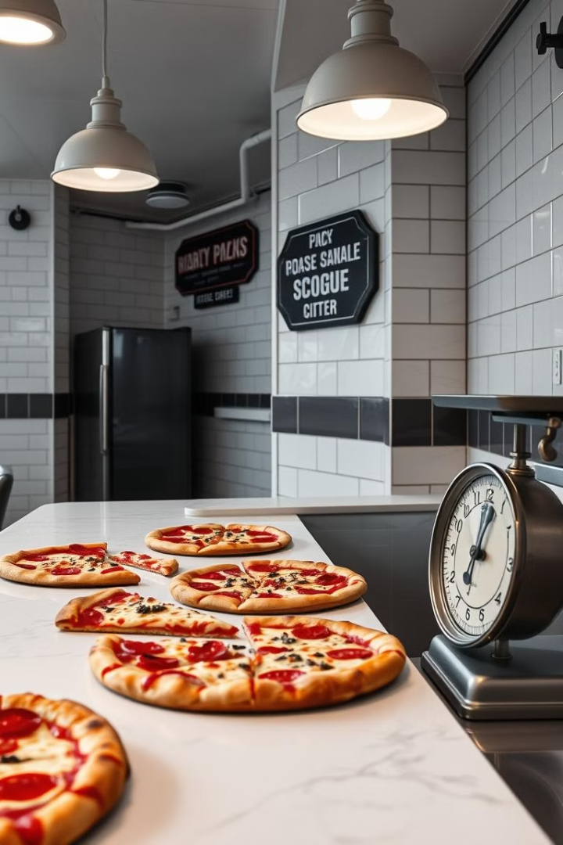
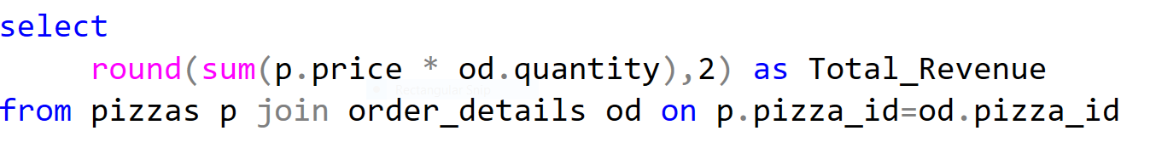
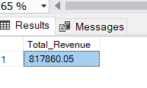
Calculate total revenue generated from pizza sales.

Slide 6
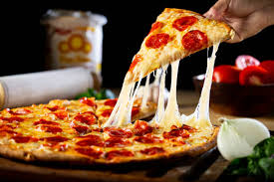
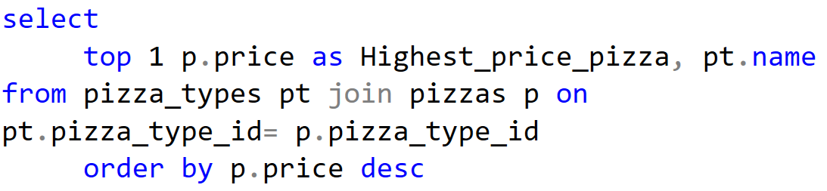
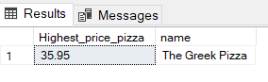
Identify the highest price pizza

Slide 7

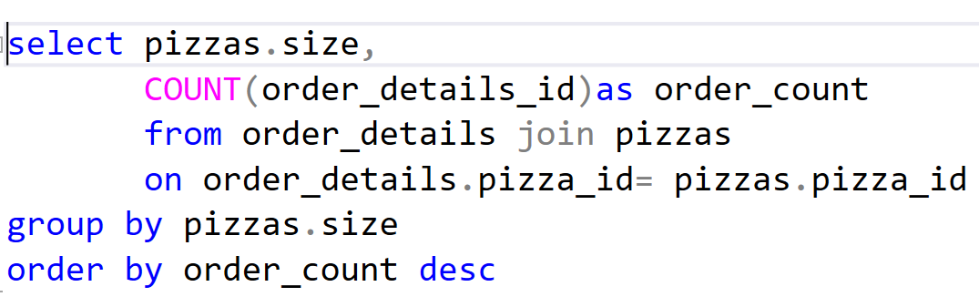
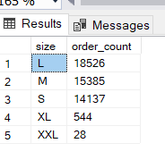
Identify most common pizza size ordered

Slide 8
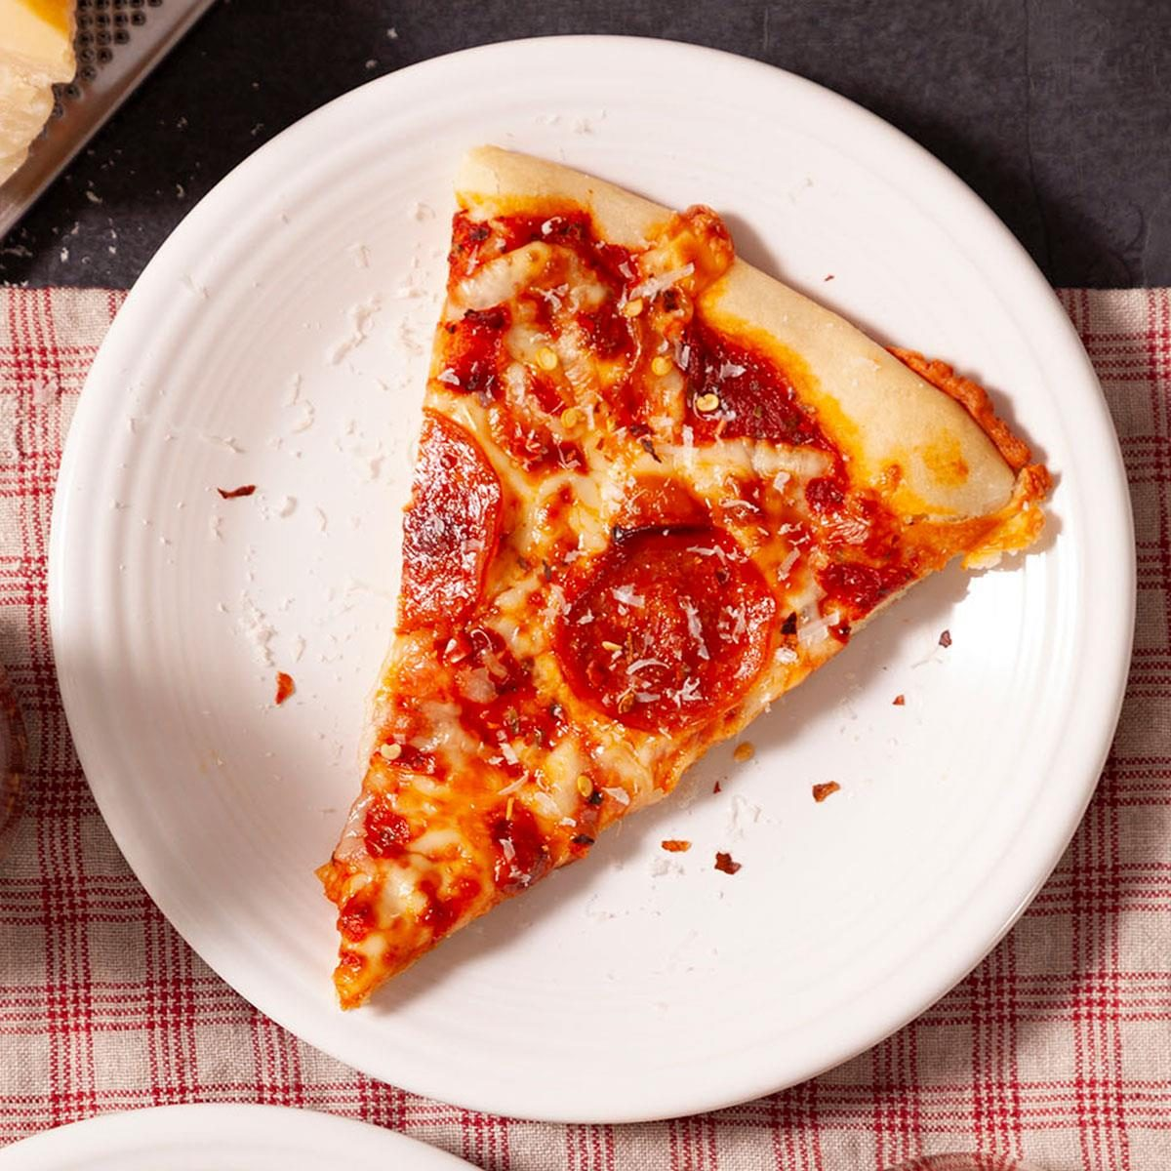
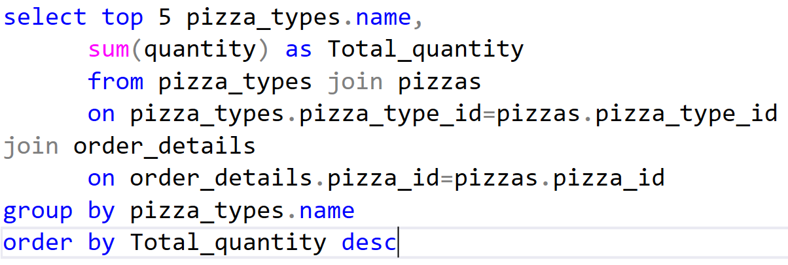
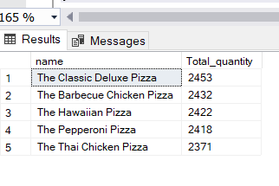
List the top 5 most ordered pizzas types along with
their quantities

Slide 9

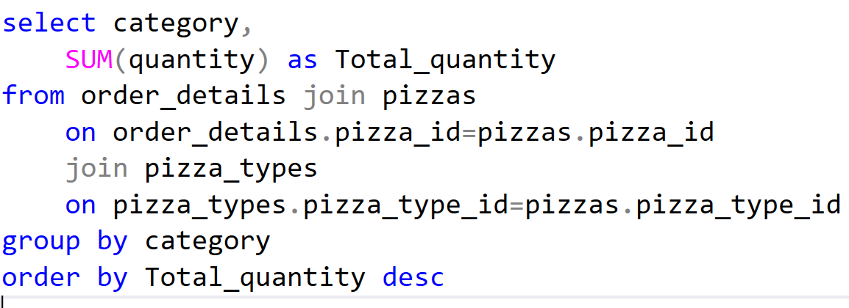
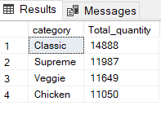
Join the necessary tables to find the total quantity of
each pizza category ordered

Slide 10

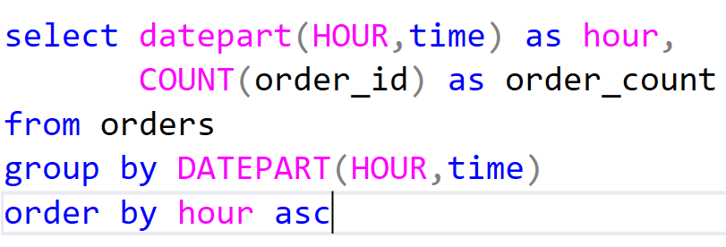
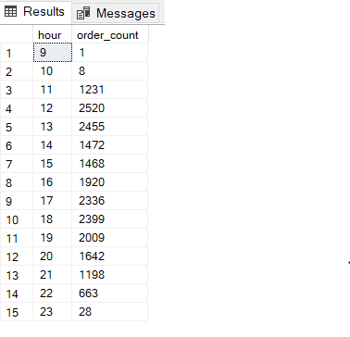
Determine the distribution of orders by hour
of the day

Slide 11
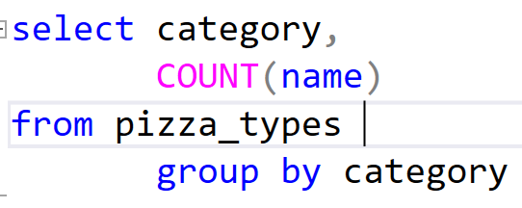
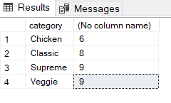
Join the relevant tables to find the category wise
distribution of pizzas

Slide 12

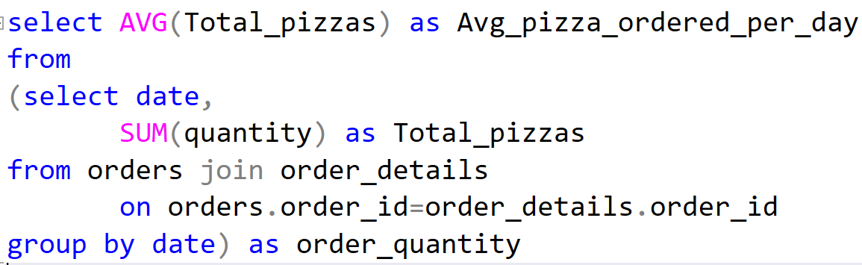
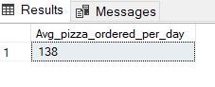
Group the orders by date and calculate the average
number of pizzas ordered per day.

Slide 13

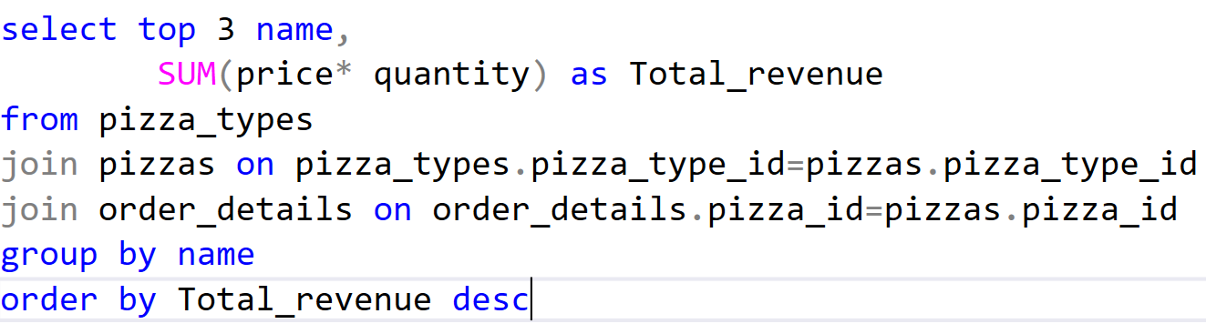
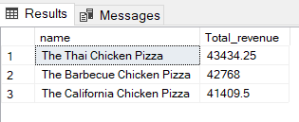
Determine the top 3 most ordered pizza types
based on revenue.

Slide 14
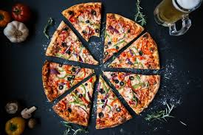
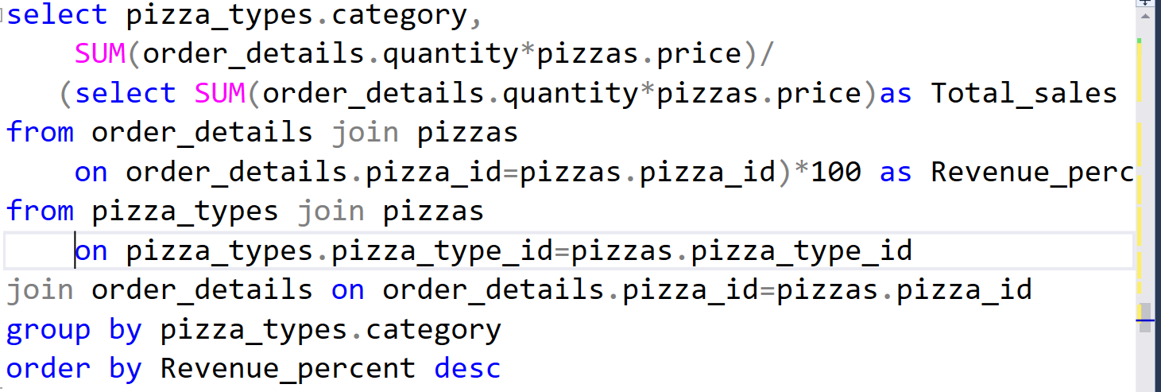
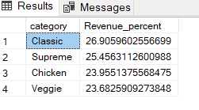
Calculate the percentage contribution of each pizza type to total revenue

Slide 15
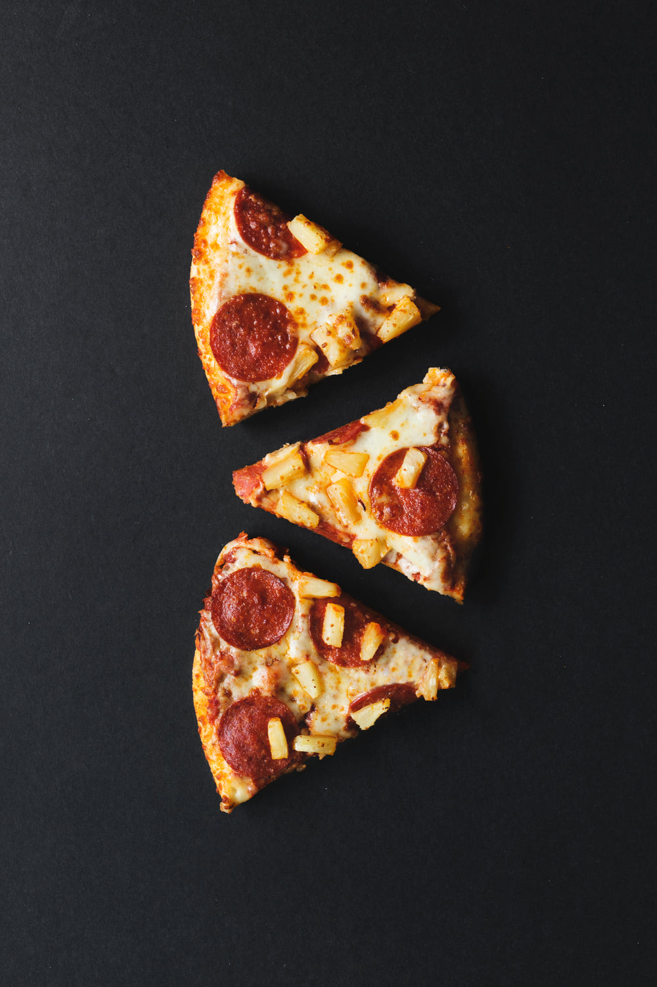
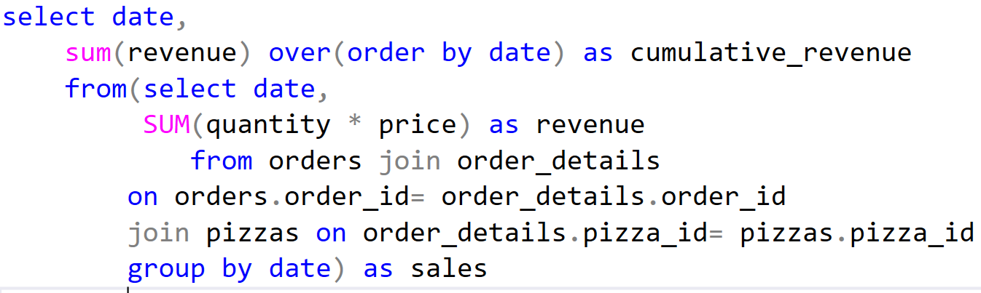
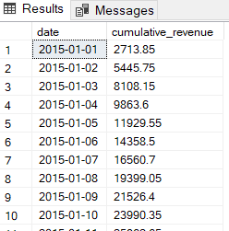
Analyze the cumulative revenue generated over time

Slide 16

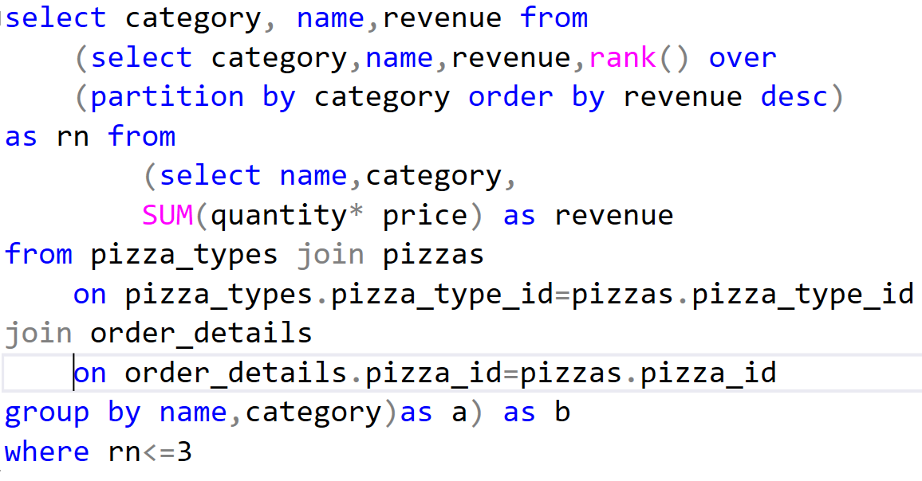
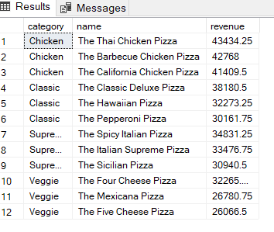
Determine the top 3 most ordered pizza types based on revenue for each pizza category.

Slide 17
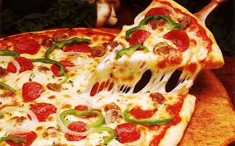
Conclusion and insights
After analyzing and performing SQL query operation we found that
classic category pizza sold more.
We found insights that pizza store is getting more orders
in afternoon 12PM to 1PM and in evening 5PM to 7PM
Top 3 pizzas are chicken category pizzas which are
generating more revenue.

Slide 18
THANK YOU

